Slide 1


PYTHON
Lecture 45

Slide 2

Today’s Agenda
Advance Concepts Of Object Oriented Programming-III
MultiLevel Inheritance
Hierarchical Inheritance
Using The Function issubclass( )
Using The Function isinstance( )

Slide 3
MultiLevel Inheritance
Multilevel inheritance is also possible in Python like other Object Oriented programming languages.
We can inherit a derived class from another derived class.
This process is known as multilevel inheritance.
In Python, multilevel inheritance can be done at any depth.

Slide 4
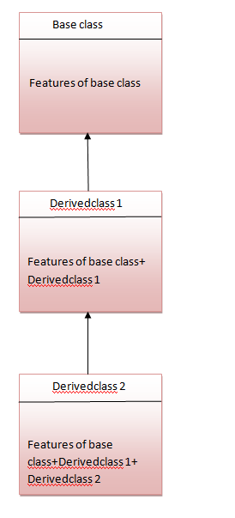
MultiLevel Inheritance

Slide 5
Syntax
class A:
# properties of class A
class B(A):
# class B inheriting property of class A
# more properties of class B
class C(B):
# class C inheriting property of class B
# thus, class C also inherits properties of class A
# more properties of class C

Slide 6
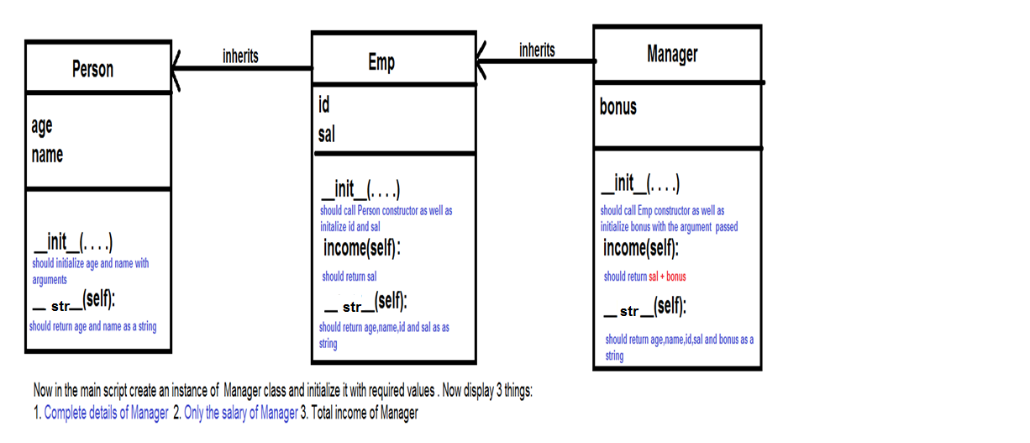
Exercise
Write a program to create 3 classes Person , Emp and Manager.

Slide 7
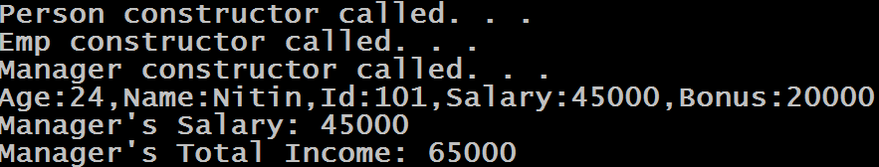
Desired Output

Slide 8
Solution
class Person:
def __init__(self,age,name):
self.age=age
self.name=name
print("Person constructor called. . .")
def __str__(self):
return f"Age:{self.age},Name:{self.name}"
class Emp(Person):
def __init__(self,age,name,id,sal):
super().__init__(age,name)
self.id=id
self.sal=sal
print("Emp constructor called. . .")
def income(self):
return self.sal
def __str__(self):
str=super().__str__()
return f"{str},Id:{self.id},Salary:{self.sal}"

Slide 9
Solution
class Manager(Emp):
def __init__(self,age,name,id,sal,bonus):
super().__init__(age,name,id,sal)
self.bonus=bonus
print("Manager constructor called. . .")
def income(self):
total=super().income()+self.bonus
return total
def __str__(self):
str=super().__str__()
return f"{str},Bonus:{self.bonus}"
m=Manager(24,"Nitin",101,45000,20000)
print(m)
print("Manager's Salary:",Emp.income(m))
print("Manager's Total Income:",m.income())
Output:

Slide 10
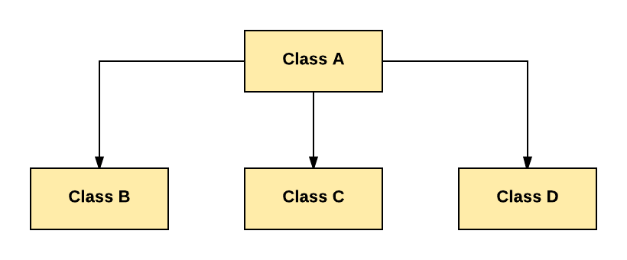
Hierarchical Inheritance
In Hierarchical Inheritance, one class is inherited by many sub classes.

Slide 11
Hierarchical Inheritance
Suppose you want to write a program which has to keep track of the teachers and students in a college.
They have some common characteristics such as name and age.
They also have specific characteristics such as salary for teachers and marks for students.

Slide 12
Hierarchical Inheritance
One way to solve the problem is that we can create two independent classes for each type and process them.
But adding a new common characteristic would mean adding to both of these independent classes.
This quickly becomes very exhaustive task

Slide 13
Hierarchical Inheritance
A much better way would be to create a common class called SchoolMember and then have the Teacher and Student classes inherit from this class
That is , they will become sub-types of this type (class) and then we can add specific characteristics to these sub-types

Slide 14
Example
class SchoolMember:
def __init__(self, name, age):
self.name = name
self.age = age
print("Initialized SchoolMember:",self.name)
def tell(self):
print("Name:",self.name,"Age:",self.age, end=" ")

Slide 15
Example
class Teacher(SchoolMember):
def __init__(self, name, age, salary):
super().__init__(name, age)
self.salary = salary
print("Initialized Teacher:", self.name)
def tell(self):
super().tell()
print("Salary:",self.salary)

Slide 16
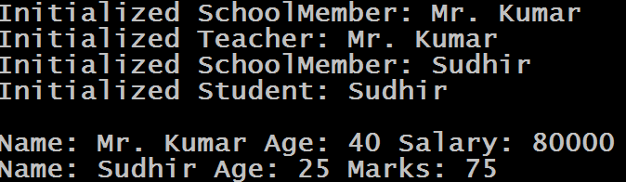
Example
class Student(SchoolMember):
def __init__(self, name, age, marks):
super().__init__(name, age)
self.marks = marks
print("Initialized Student:",self.name)
def tell(self):
super().tell()
print("Marks:",self.marks)
t = Teacher('Mr. Kumar', 40, 80000)
s = Student('Sudhir', 25, 75)
print()
members = [t, s]
for member in members:
member.tell()
Output

Slide 17
How To Check Whether A Class Is A SubClass Of Another ?
Python provides a function issubclass() that directly tells us if a class is a subclass of another class.
Syntax:
issubclass(<name of der class>,<name of base class>)
The function returns True if the classname passed as first argument is the derive class of the classname passed as second argument otherwise it returns False

Slide 18
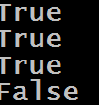
Guess The Output ?
class MyBase(object):
pass
class MyDerived(MyBase):
pass
print(issubclass(MyDerived, MyBase))
print(issubclass(MyBase, object))
print(issubclass(MyDerived, object))
print(issubclass(MyBase, MyDerived))
Output:

Slide 19
Guess The Output ?
class MyBase:
pass
class MyDerived(MyBase):
pass
print(issubclass(MyDerived, MyBase))
print(issubclass(MyBase, object))
print(issubclass(MyDerived, object))
print(issubclass(MyBase, MyDerived))
Output:
In Python 3 , every class implicitly inherits from object class but in Python 2 it is not so. Thus in Python 2 the 2nd and 3rd print( ) statements would return False

Slide 20
Alternate Way
Another way to do the same task is to call the function isinstance( )
Syntax:
isinstance(<name of obj ref>,<name of class>)
The function returns True if the object reference passed as first argument is an instance of the classname passed as second argument or any of it’s subclasses. Otherwise it returns False

Slide 21

Guess The Output ?
class MyBase:
pass
class MyDerived(MyBase):
pass
d = MyDerived()
b = MyBase()
print(isinstance(d, MyBase))
print(isinstance(d, MyDerived))
print(isinstance(d, object))
print(isinstance(b, MyBase))
print(isinstance(b, MyDerived))
print(isinstance(b, object))
Output:

